Slide 1
Digital Lending: Portfolio Optimization

Slide 2
The Digital Lending Landscape
Rise of embedded finance and instant credit models.
Strategic shift from legacy branch-led lending to app-first ecosystems.
Increased regulatory oversight focusing on data privacy and transparency.

Slide 3
Portfolio Optimization Objectives
Maximize net interest margin while strictly controlling credit risk.
Improve the accuracy of borrower segmentation and profiling.
Optimize capital allocation across diverse loan products to enhance liquidity.

Slide 4
Data-Driven Lending Architecture
Integration of alternative data sources for underwriting (e.g., utility payments, transaction data).
Deployment of real-time behavioral analytics to monitor credit health.
Scalable AI/ML engines for rapid credit scoring and decisioning.

Slide 5
Risk Segmentation & Credit Scoring
Dynamic borrower risk categorization adapting to market fluctuations.
Advanced Probability of Default (PD) modeling based on historical and real-time inputs.
Implementation of early warning systems to flag potential delinquencies before default.

Slide 6
Portfolio Diversification Strategies
Geographic and demographic diversification to mitigate localized economic shocks.
Strategic product-mix balancing between high-yield and low-risk assets.
Exposure concentration controls to prevent over-reliance on single borrower segments.

Slide 7
AI & Predictive Analytics in Optimization
Predictive forecasting to anticipate portfolio performance trends.
Automated pricing optimization models based on real-time risk profile.
Smart collections and recovery workflows utilizing machine learning for prioritized outreach.

Slide 8
Regulatory & Compliance Considerations
Adherence to evolving digital lending compliance frameworks.
Robust model governance and data privacy controls.
Ensuring Responsible AI and bias mitigation to align with fair lending standards.

Slide 9
KPIs for Portfolio Performance
NPA (Non-Performing Asset) ratio and delinquency tracking.
Risk-Adjusted Return on Capital (RAROC) monitoring.
Ongoing tracking of Customer Lifetime Value (CLV) and retention metrics.

Slide 10
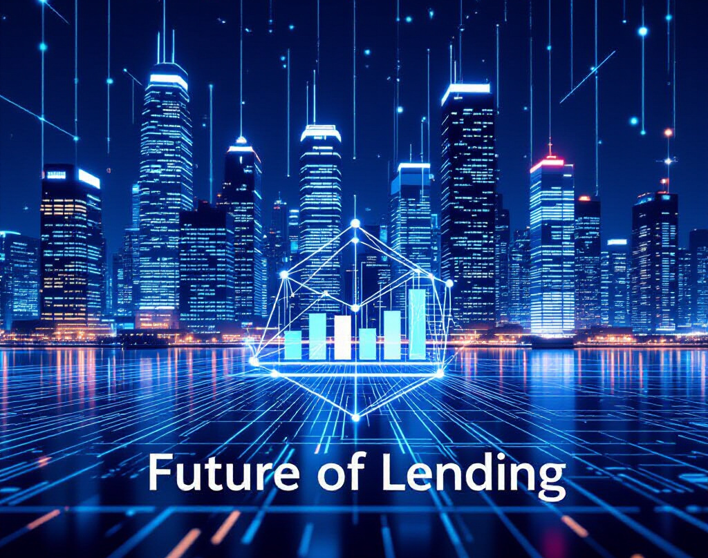
Future of Digital Lending
AI-driven autonomous lending ecosystems and fully integrated credit journeys will define the next generation of banking.

